Slide 1
Measures of Central Tendency

Slide 2
Central Tendency
There are three measures of Central Tendencies:
Mean
Median
Mode

Slide 3
Mean
It is the AVERAGE of a data set
Example
Data set = 3,5,1,4,5,8,2.
No. of elements in Data Set = 7
Then, Mean = (3+5+1+4+5+8+2) / 7
= 28/7
Mean =4

Slide 4
Median
It is the MIDDLE of the set of numbers.
Reorder the data set in ascending order
Find the middle number in the set
Example
Data set = 3,5,1,4,5,8,2.
Reordered data set = 1,2,3,4,5,5,8
Median = 4

Slide 5
Mode
It is the MOST REPEATED number in a data set.
Example:
Data set = 3,5,1,4,5,8,2.
Mode = 5

Slide 6
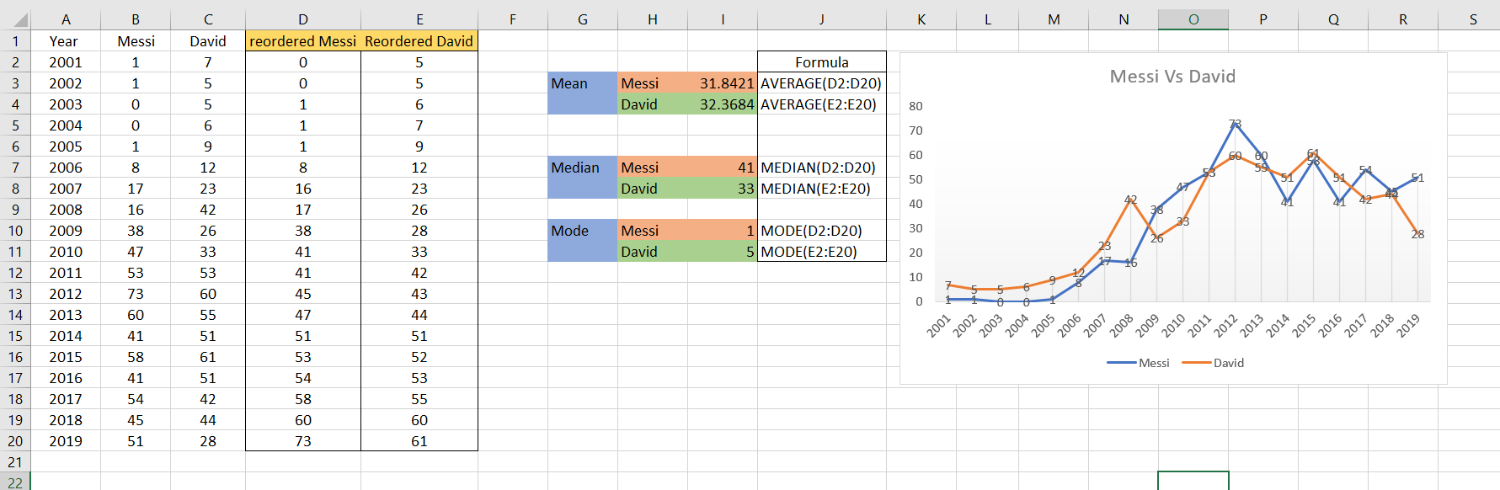
Central Tendency in EXCEL
Here I’m had taken a data of goals scored by the two football payers Messi and David from the year of 2001 to 2019.

Slide 7
Thank You

